Slide 1

House prices Analisis
Hussein Yousry

Slide 2
Introduction
Real Estate Market Analysis
Content:
Overview of the real estate market analysis.
Objectives and goals of the analysis.
Key areas of focus.
Hussein Yousry

Slide 3
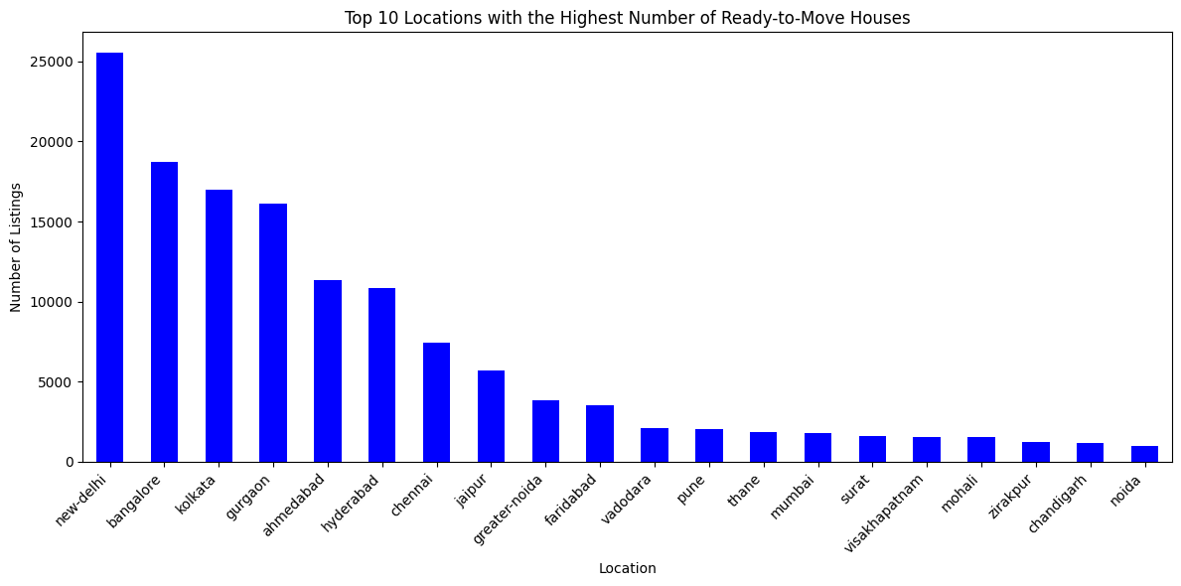
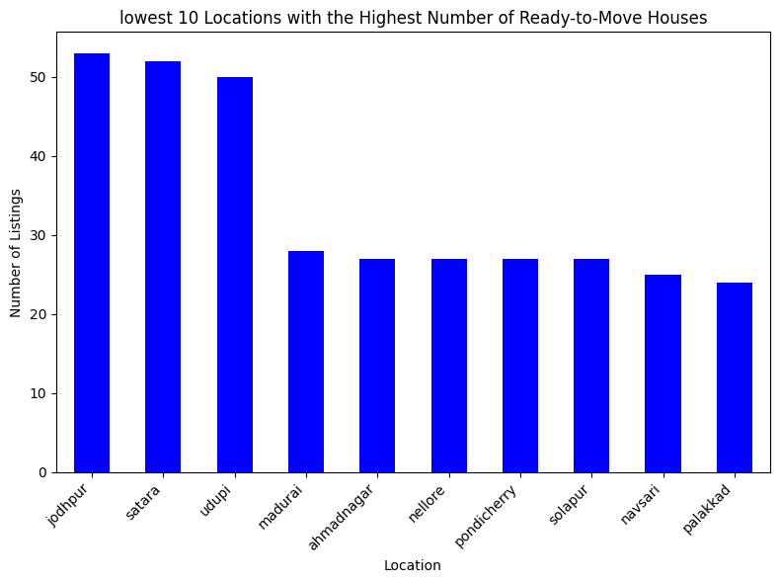
Q1 - What is the top and lowest 2 city that have the heights 'ready to move' per city?
Top 2 city:
New Delhi & Bangalore: New Delhi and Bangalore both have the highest number of ready-to-move houses, with approximately 25,000 and 22,000 listings respectively. These cities should be the first options to consider if you need to find a house quickly or if you're looking for a wide variety of options.
Lowest 2 city:
Jodhpur & Satara: Greater Noida has around 8,000 listings, and Faridabad has the smallest number of ready-to-move houses among the top 10 locations, with around 5,000 listings. While the options in these locations might be more limited compared to New Delhi and Bangalore, they could still be viable choices depending on your specific requirements. The smaller number of listings may indicate less competition and potentially better deals.

Slide 4
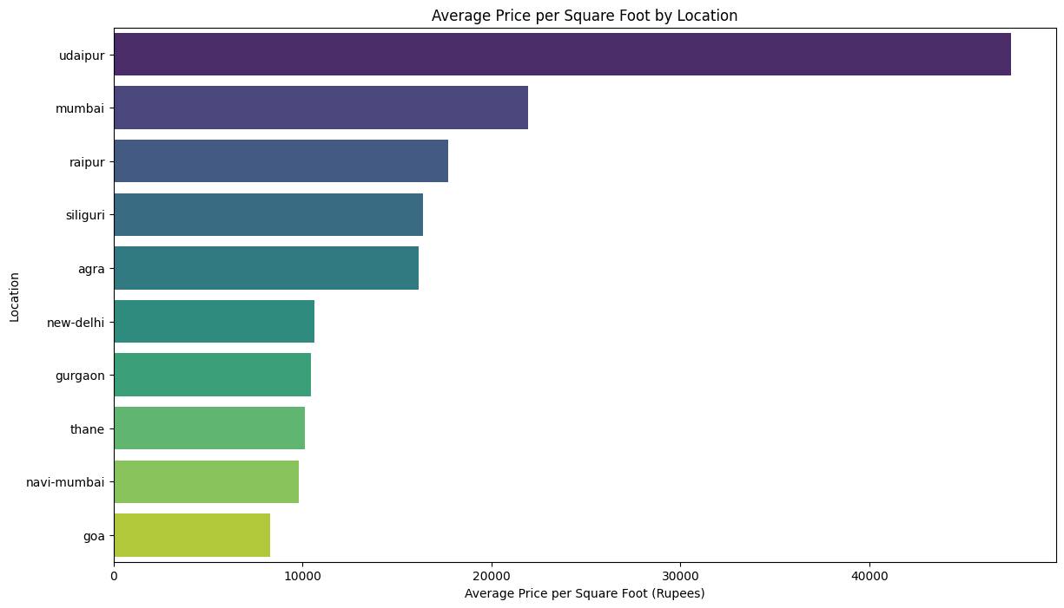
Q2 - What is the average price per square foot for properties across different locations?
Udaipur has the highest average price(over 40,000/sqft) among the top 10 locations, this means that this city have a high market value. On the other hand, Navi-Mumbai and Goa citys has the lowest avg price for sqft which can be considered for anyone who want low prices or want a good deals for buyers.

Slide 5
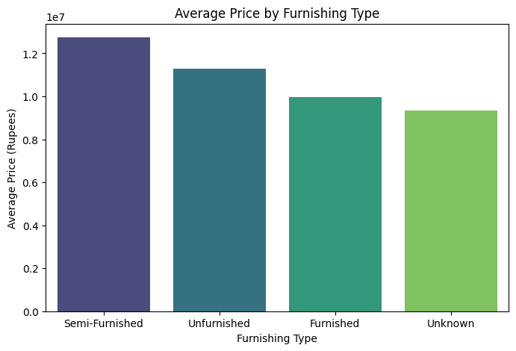
Q3 - Price comparison by furnishing type?
Semi-furnished houses have the highest average prices, followed by un-furnished and furnished properties. This indicates that semi-furnishing increased the property prices.

Slide 6
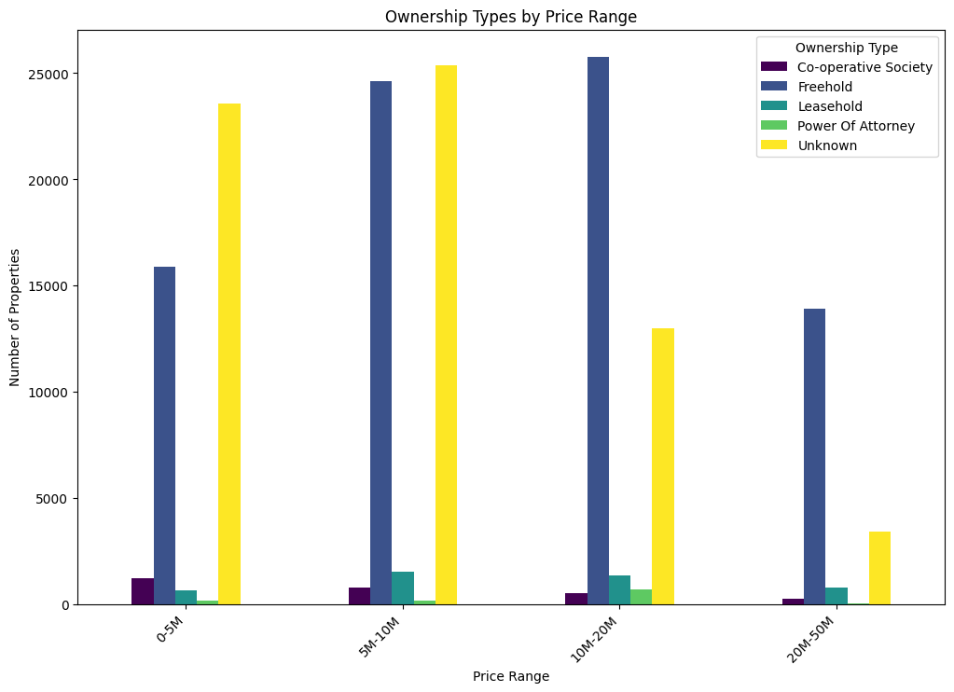
Q4 ownership types vs price range in ascending order?
In the price category 10-20m the heights type of houses are Co-operative followed by Unknown (Call to know the price)

Slide 7
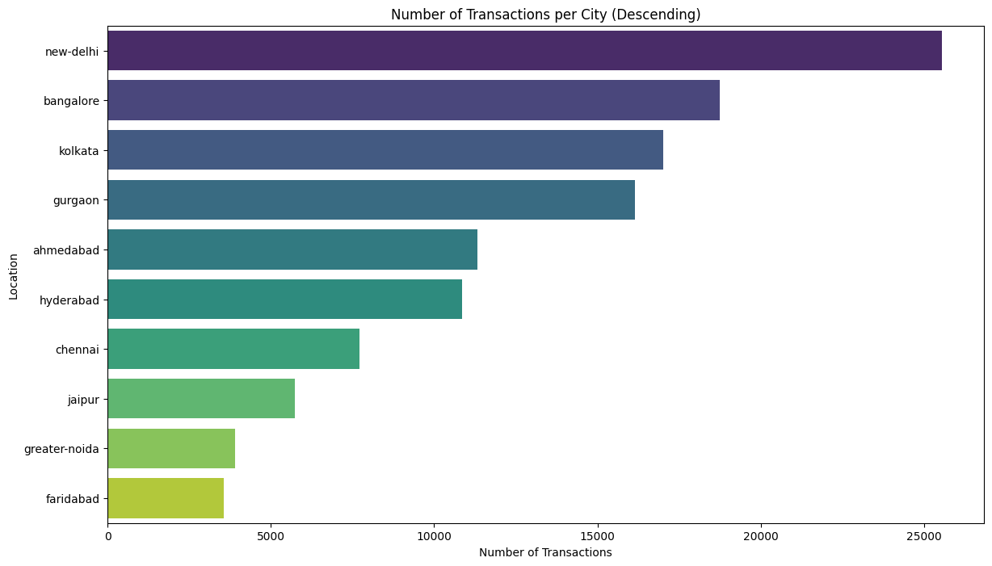
Q5 What is the heights city that have most number of transactions?
New-Delhi is the most city that have the heights numbers of transactions, followed by Bangalore. This indicates that the those two city are not good to long term investment duration.

Slide 8
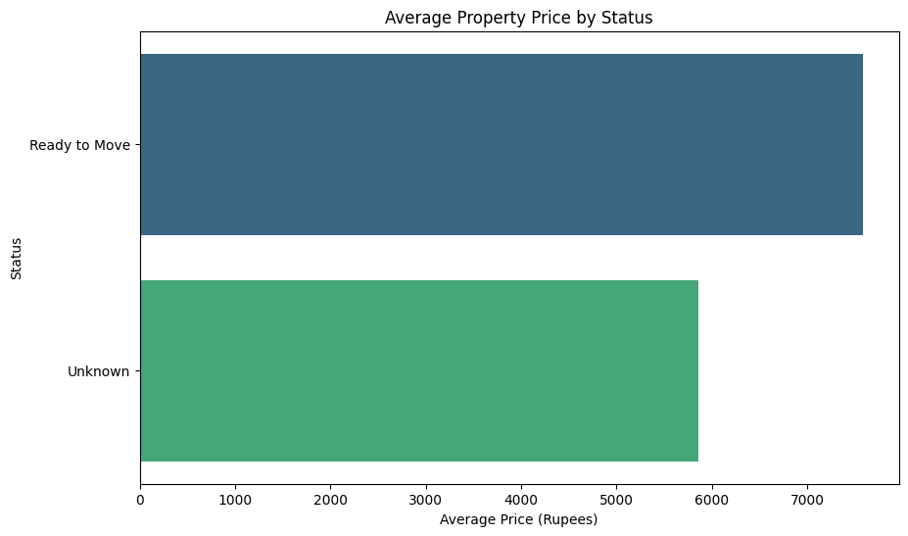
Q5 What is the co-relationship between price and super area?
This indicated that when the proprieties have more information such as price it can optain more sales and high prices more than it lablel that call to know the price.

